Slide 1
Accelerometer-Based, Grip-Free Controller
Tyler (You-Chi) Le
ECE4220
Fall 2011
Dr. DeSouza
December 5th, 2011

Slide 2
A Quick Overview
What is the project?
A glove-integrated sensor that detects hand orientation using real-time tasks to provide control various applications
Aimed to demonstrate a flexible and dynamic alternative to the traditional controller and joystick
Prototype for demonstrations for both gaming and vehicular control for disabled persons
Two simulation programs demonstrate potential usage

Slide 3
Purpose
Provide a flexible, cheap, and dynamic controller for operation of vehicles, simulations, and games
Integrated with glove to replace fixed-shaped joysticks
Motion-based controls for ease of use
Configurable sensitivity to accommodate varying ranges of motion
Packaged with two graphical simulations to demonstrate potential usage and applicability

Slide 4
Motivation (Background)
For disabled individuals:
Current camera-based and optical motion sensors need min. distance and proper lighting, not appropriate for inside of cars or inside of confined spaces
Present joysticks are limited by design shape and have limited usability
Many joysticks require gripping an object rather than hand movement (May prove troublesome for people with lack of grip strength or finger damage/injuries)
Desire to provide a easy-to-configure, easy-to-use prototype for vehicle control (possibly for wheelchairs or cars)

Slide 5
Motivation Cont.
For video game control:
Game system controllers are limited by design shape and have limited usability in representing different types of motion
Minimum distance for optical sensors not applicable for PC’s as users have to be close to keyboard and mouse
Joysticks and driving wheels are costly and single-purposed

Slide 6
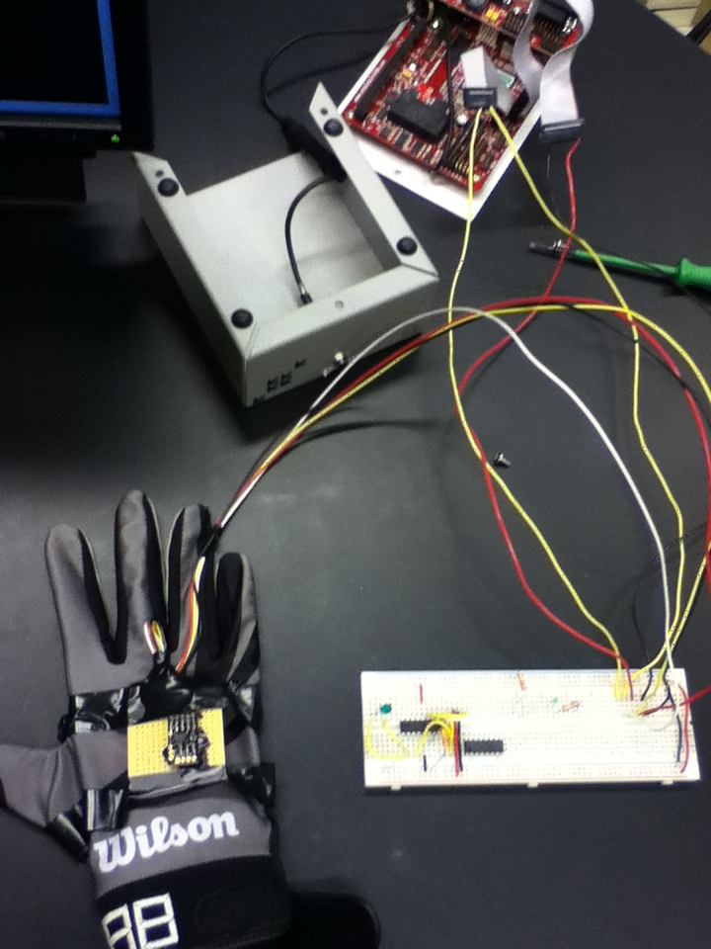
Proposed Implementation
Hardware:
Detect hand orientation using an analog 2-axis accelerometer
Accelerometer is affixed to top of glove, no finger grip necessary
Power drawn from TS-7250 DIO lines
TS-7250 on-board ADC measures analog output of accelerometer to measure tilt/orientation*
*MAX197 Add-on is not available on TS-7250’s in lab

Slide 7
Integrated ADC on TS-7250
MAX197, not avail. In current lab TS-7250
Integrated ADC
5 Channels

Slide 8
Hardware Block Diagram
2-Axis Accelerometer
ADC and TS-7250 Embedded System
Network Server
Linux Terminal

Slide 9
Proposed Implementation
Software:
Control registers for ADC as well as ADC results are mapped to the compiler using mmap() and provided addresses
Four pthreads initialize real-time tasks that operate in sequence to produce graphical simulations based on hand orientation
Real-time tasks operate with 0.1 second periods for 10 Hz axis measurements, simulation update, and graphic output
Character array-based graphics printed through the Linux Terminal for graphical output
User-configured range of motion at initialization for varying sensitivity

Slide 10
Proposed Implementation
Real-time (RT) Structure:
Two RT tasks poll the output of the 2-axis accelerometer and store result into two shared buffers
A third RT task reads from the shared buffers to update graphical positions of various simulation components
Fourth RT task prints the updated character arrays to the Terminal, producing the graphical display
Each task prevents the next successive task from execution before completion using semaphores

Slide 11
Software Block Diagram
Update Graphics
Measure H-Axis
Shared Buffer
Shared Buffer
SEM1
Measure V-Axis
SEM2
Display Graphics
SEM3

Slide 12
Real-Time Concepts Used
Pthreads – multithread operation
Periodic RT tasks
Semaphores
Shared buffer
Producer-Consumer Structure
I/O Polling
Priority Scheduling

Slide 13
Results
TS-7250 produces measurements and displays consistent with hand motion
Simulations demonstrate both practical usage and gaming application for proposed prototype
User-defined minimum and maximum values allow customizable range of motion
The prototype cost around $15 dollars excluding the TS-7250

Slide 14
Potential Improvements
Migrate functionality to the MAX197 Optional Add-on ADC for better accuracy and faster sampling
Better accuracy would result in better resolution, allowing smaller minimal range of motion
Expansion of buffer and threads to allow 6 axis, both-hands operation
Utilizing display drivers or programs that minimize processing speed to allow faster refresh rate
Implementation to prevent unintentional acceleration through averaging algorithms
Wirelessly integrate ADC and accelerometer

Slide 15
Potential Implementations
Placed on hand, head, and/or fingers to sense orientation for vehicular control for disabled persons
“Makeshift” joystick similar to Nintendo Wii controllers, but with no required physical hardware to grip
Robotics control
Transport what is already available on many mobile devices to larger-scale applications

Slide 16
Conclusion
Demonstrates a flexible and configurable prototype for a non-conventional controller
Provides a motion sensing module that does not require grip and holding an object
Potentially beneficial towards people with disabilities lacking a large range of motion or grip strength
Demonstrates potential to replace a wide variety of single-purpose video game joysticks (cost-saving)
Can be used in confined spaces on systems larger than mobile devices
Successfully demonstrates usage of real-time design in simulation and controller

Slide 17
Questions?

