Slide 1
DC Motor Control
By
Tony Hoff
ECE 4220 – Real Time Embedded Computing
University of Missouri - Columbia
Course Instructor:
Dr. Guiherme DeSouza

Slide 2
Introduction
My group capstone project involved using an electric motor vehicle (viewed right)
Some group members had issues implementing the motor control.
This project aims to implement the motor control in RT
Project Goals:
Implement PWM to control power to both motors in real time
Read encoders to estimate the speed of both motors in real time

Slide 3
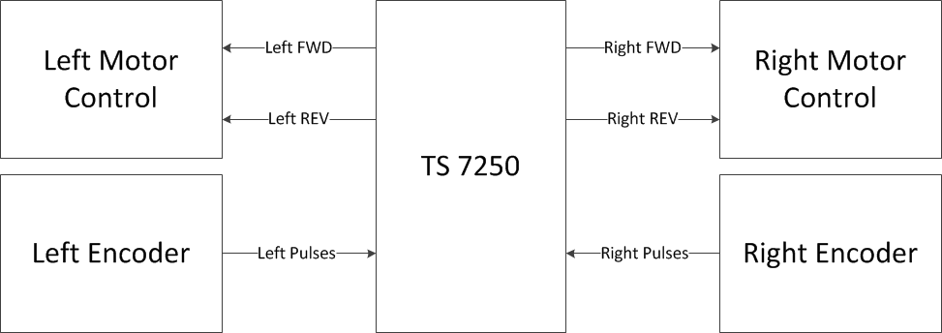
Hardware and Signal Requirements

Slide 4
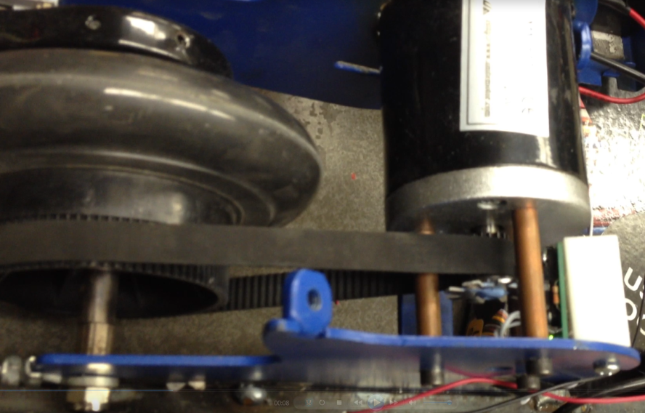
Motor Speed Calculation
The optical encoder switches on when nothing obstructs its light path
When a fin obstructs the light path it switches off
There are 8 gaps on the encoder and the axis of the encoder is 5 times smaller than the axis of the wheel
So for every complete wheel rotation, the encoder switches from high to low 40 times
Encoder

Slide 5
Pulse Width Modulation
The average value of voltage fed to the load is controlled by turning the switch between supply and load on and off at a fast pace.
The longer the switch is on compared to the off periods, the higher the power supplied to the load

Slide 6
Alternative Implementations
Using Hardware for PWM
Advantages:
Conserves CPU processing time
Simplifies software
Disadvantages:
Requires the use of more DIO pins
Requires additional components
Difficult to adjust and troubleshoot
Reading the ADC using usleep() instead of RT
Advantages:
Simplifies coding the software
Disadvantages:
Non-deterministic speed readings could be significantly less accurate

Slide 7
Alternative Implementations (Continued)
Using A single thread
Advantages
Simplifies coding
Requires no inter-process communication
Disadvantages
Code becomes less modular and therefore more difficult to change and trouble shoot
Can not read ADC, send power, and except commands in parallel

Slide 8
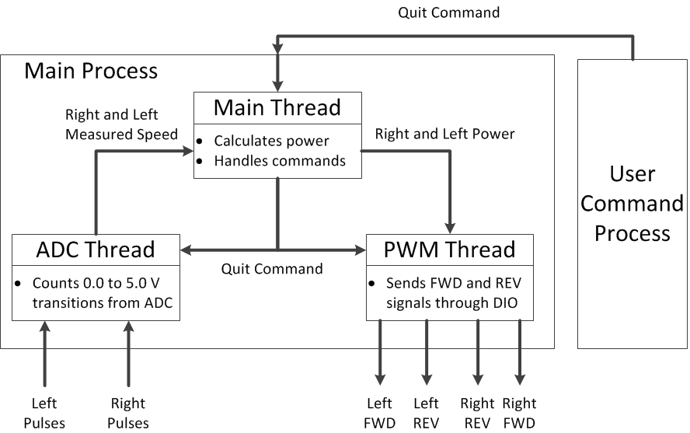
Proposed Implementation

Slide 9
PWM Thread
Each motor has an integer power level that ranges from -100 to 100.
The power sent to the motors updates once every 100 ms
A positive power sets the FWD pin and a negative power sets the REV pin for each motor
The absolute value of the power determines the duty cycle for each pin
Two semaphores were used to control the writes and reads between the PWM thread and the main thread
Another semaphore was used to signal the thread to exit. This way the motors would always be turned off at the end

Slide 10
ADC Reading Thread
Reads two channels of the ADC. The maximum speed of the motors with no load is approximately 475 Hz so a 1.0 kHz sample rate was chosen
The count of transitions for the last 200 ms are stored in a buffer. So the accuracy of the encoder can only be +/- 5 Hz
The frequency can be determined by the number of counts in the buffer
Two semaphores were used to control the writes and reads between the ADC thread and the main thread
Another semaphore was used to signal the thread to exit

Slide 11
Main Thread
Calculates the power sent to each motor based on the difference between the set speed and the measured speed
Reads named pipes for data sent from the user command process and any other processes
Uses semaphores to ensure proper use of shared memory

Slide 12
Motor Control Video - 1

Slide 13
Motor Control Video - 2

Slide 14
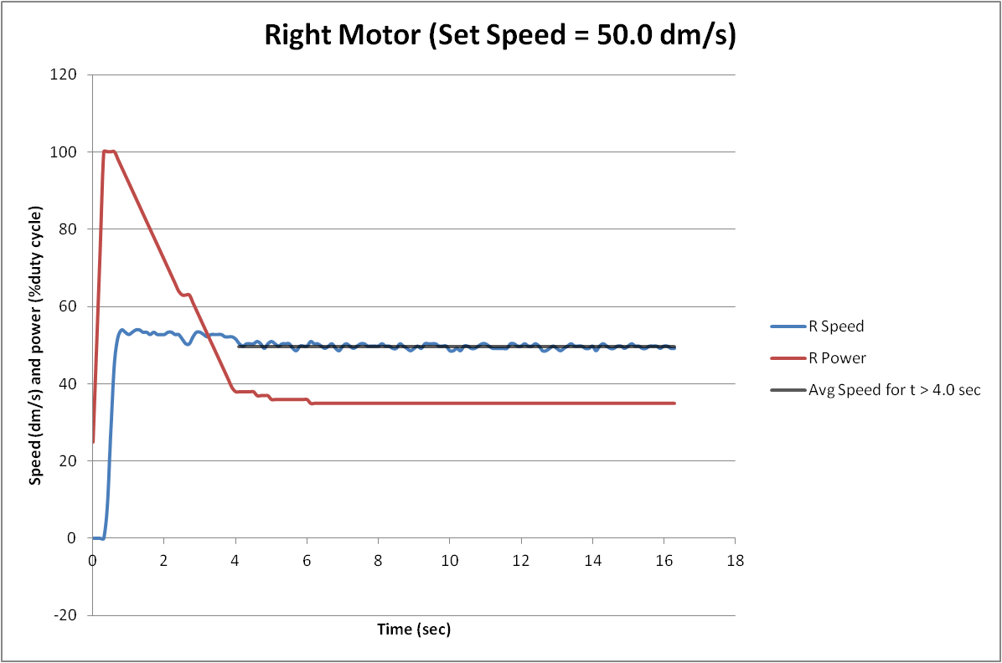
Right Measured Speed vs. Power
Average Speed for t > 4.0 sec = 49.60 dm/s

Slide 15
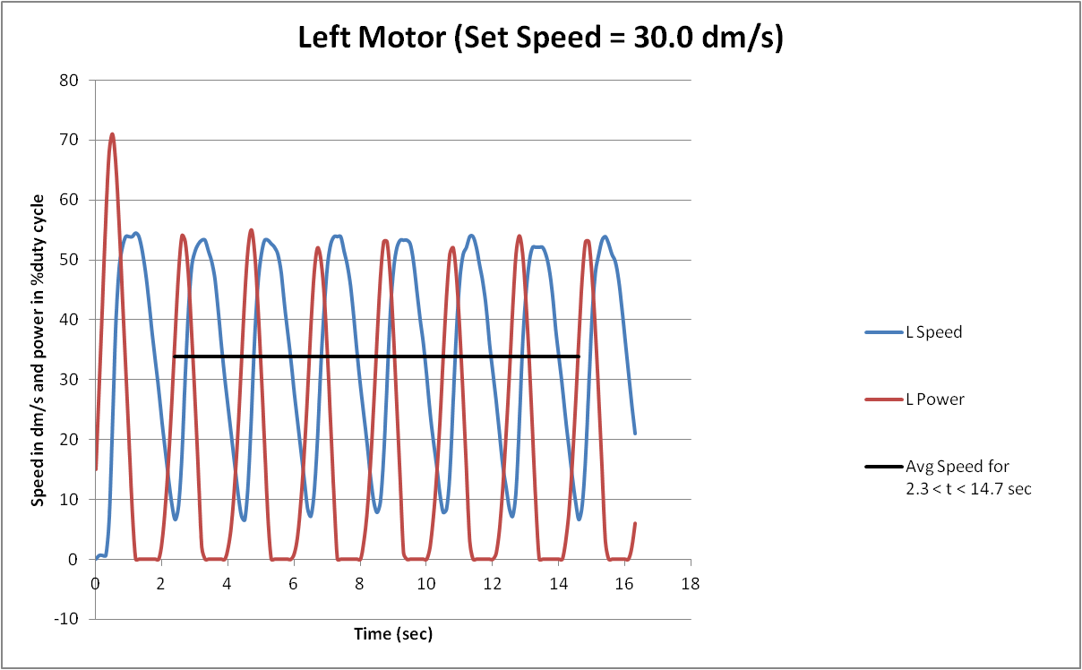
Left Measured Speed vs. Power
Average Speed for 2.3 < t < 14.7 sec = 33.80 dm/s

Slide 16
Conclusion
I accomplished both my goals of implementing PWM to control power and to read encoders to estimate the speed in real time
Possible Future Improvements:
A proportional–integral–derivative controller (PID controller) could be used to get a better calculation of the power sent to the motors
Measuring the speed using interrputs would be more accurate

Slide 17
Questions ?

