Slide 1
SAE Formula Car:
Dash Module using FreeRTOS
Mark Schaumburg

Slide 2
The Project
Dash Module for Formula Car
  Sample pulse from engine for RPM
  Display Information
  Control gui
Can network interface
  Request data
  Provide data

Slide 3
Hardware
LCD
  20x4 HD44780 Character Lcd (4-bit parallel data interface.
Can Controller w/SPI interface
  Maxim Mcp2515
8-Bit Microcontroller
  Atmel Mega644p
  64k flash
  4k ram
  9.216 MHz clock

Slide 4
Software
Written in C for Win-Avr Gcc compiler.
Compiles to ~13k flash
Uses ~3k of static ram
FreeRTOS kernel
  10 KHz Tick
  6 Tasks
  Interprocess communication
  Shared memory
  Real-time constraints.

Slide 5
FreeRTOS
Priority-Based Scheduling and Task Control
  Round-Robin scheduling for tasks of equal priority.
  API functions for hard, soft and non-realtime tasks
Mailboxs/FIFOs (called Queues)
  Message Size, Buffer Size
Binary, Counting, and Recursive Semaphores
Kernel communication from ISR
Priority Inheritance
  Includes protections against priority inversion
Static or dynamic allocation of OS/task stacks

Slide 6
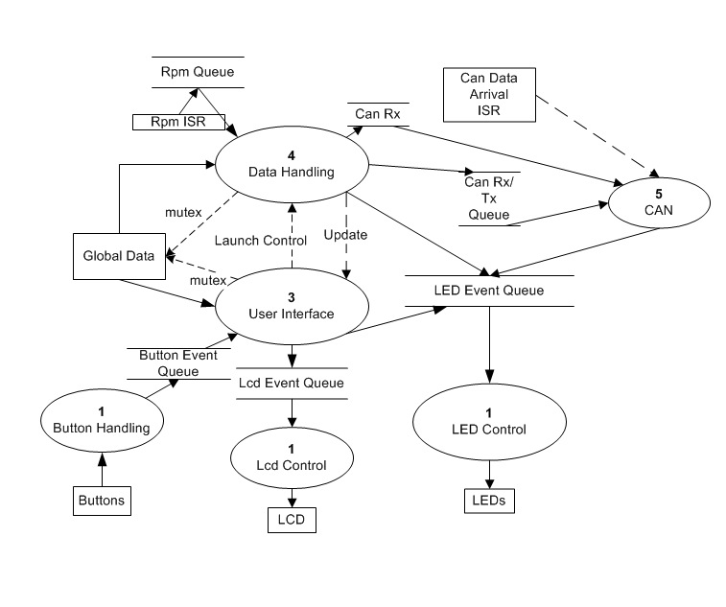
Software Diagram

Slide 7
Priority 1
Button Input
  Debounced
  Each button push=1 Button Event in the queue
  Button Held
  Send to Button Event Queue
LCD Control
  20 char buffer (1-line)
  Read from Lcd Event Queue
  Message from queue contains what line to print at
LEDS
  Read from LED event queue
  Message contains the period that the Led blinks.
Can be sufficiently starved of resources without affecting the performance of the system.

Slide 8
Priority 2
User Interface
  Still not critical, but should be more important than the priority 1 tasks.
  Takes a lot more processing power than the priority 1 tasks.
  Higher priority task than this one are designed to be blocking for a large percentage of the time so that this process does not get starved of resources.

Slide 9
Priority 3 – Soft Real-Time
Data handling
  Soft Real-Time (should try and respond to any messages within 10ms)
  Gets the Rpm pulse timestamps when directed by semaphore from ISR.
  Calculates Rpm from the time stamps
  Averages over 10 samples.
  Messages from CanRx
    Determine response and send through CanTx
    Or Store Data
  Periodically request system data from the network
  Send signal to User Interface task to update its data set.

Slide 10
Priority 4 – Hard Realtime
Can Communication
  Waits for CAN semaphore from Can ISR or Data task.
  Transmits or Receives data from the Can IC (Spi)
  Must respond to the Rx request within 10ms to avoid the hardware buffer in the can IC from filling up (causing messages to be lost).
  Automatically generates and sends responses for non data messages such as a handshake request.

Slide 11
Testing
Wireless(xBee) module on CAN network with serial interface.
Sends messages as fast as it can.
When the Can Rx Data ISR runs, it stores a timestamp.
When the message is done being prepared for sending, it puts another timestamp and current RPM into the CAN message and sends it over the network.

Slide 12
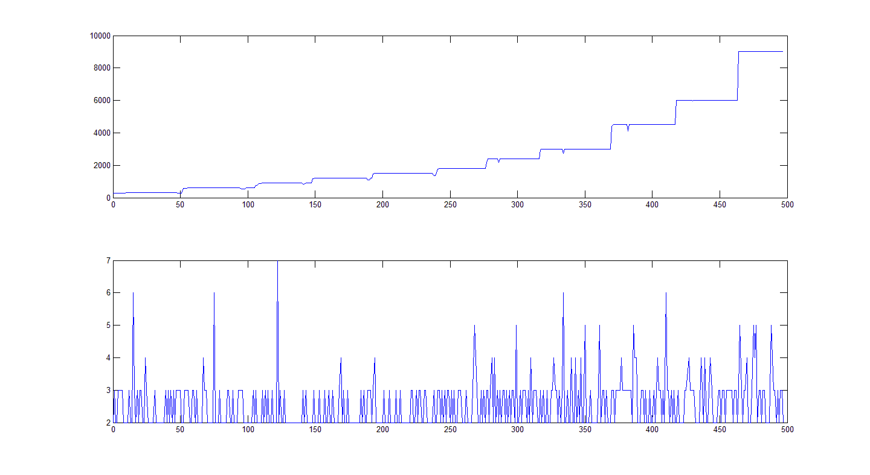
RPM and Response Delay

Slide 13
Observations
Problems
  CAN Communication w/ FreeRTOS
Memory limitations
  OS/Task/Queue Size
Rpm calculation
  Tick count resolution/trade-offs
  Solved with averaging.

Slide 14
Questions?

