Slide 1
Final Project
Alexander Popp

Slide 2
Outline
Abstract
Background
Purpose
Experimental
Results
Conclusion
Summary

Slide 3
Abstract
RTAI FIFOs are created in the real-time system
Opening a FIFO file in user space doesn’t even open a file at all
All RTAI FIFOs referenced from nodes in the file system

Slide 4
Background
Project an overall extension of Lab Three
Why is it real time?
  Utilizes processes and threads
  Flow control using semaphores
  Uses real time FIFOs as a part of real time process
Critical Concepts
  FIFOs, named, and unnamed pipes

Slide 5
Purpose
Does using a USB drive in the Linux file system change the time required to move data between user space and kernel space?
Why do this?
  Final product of trying to get a USB to work on that board in the lab.
  Understanding the fundamental nature of kernel and user space interactions

Slide 6
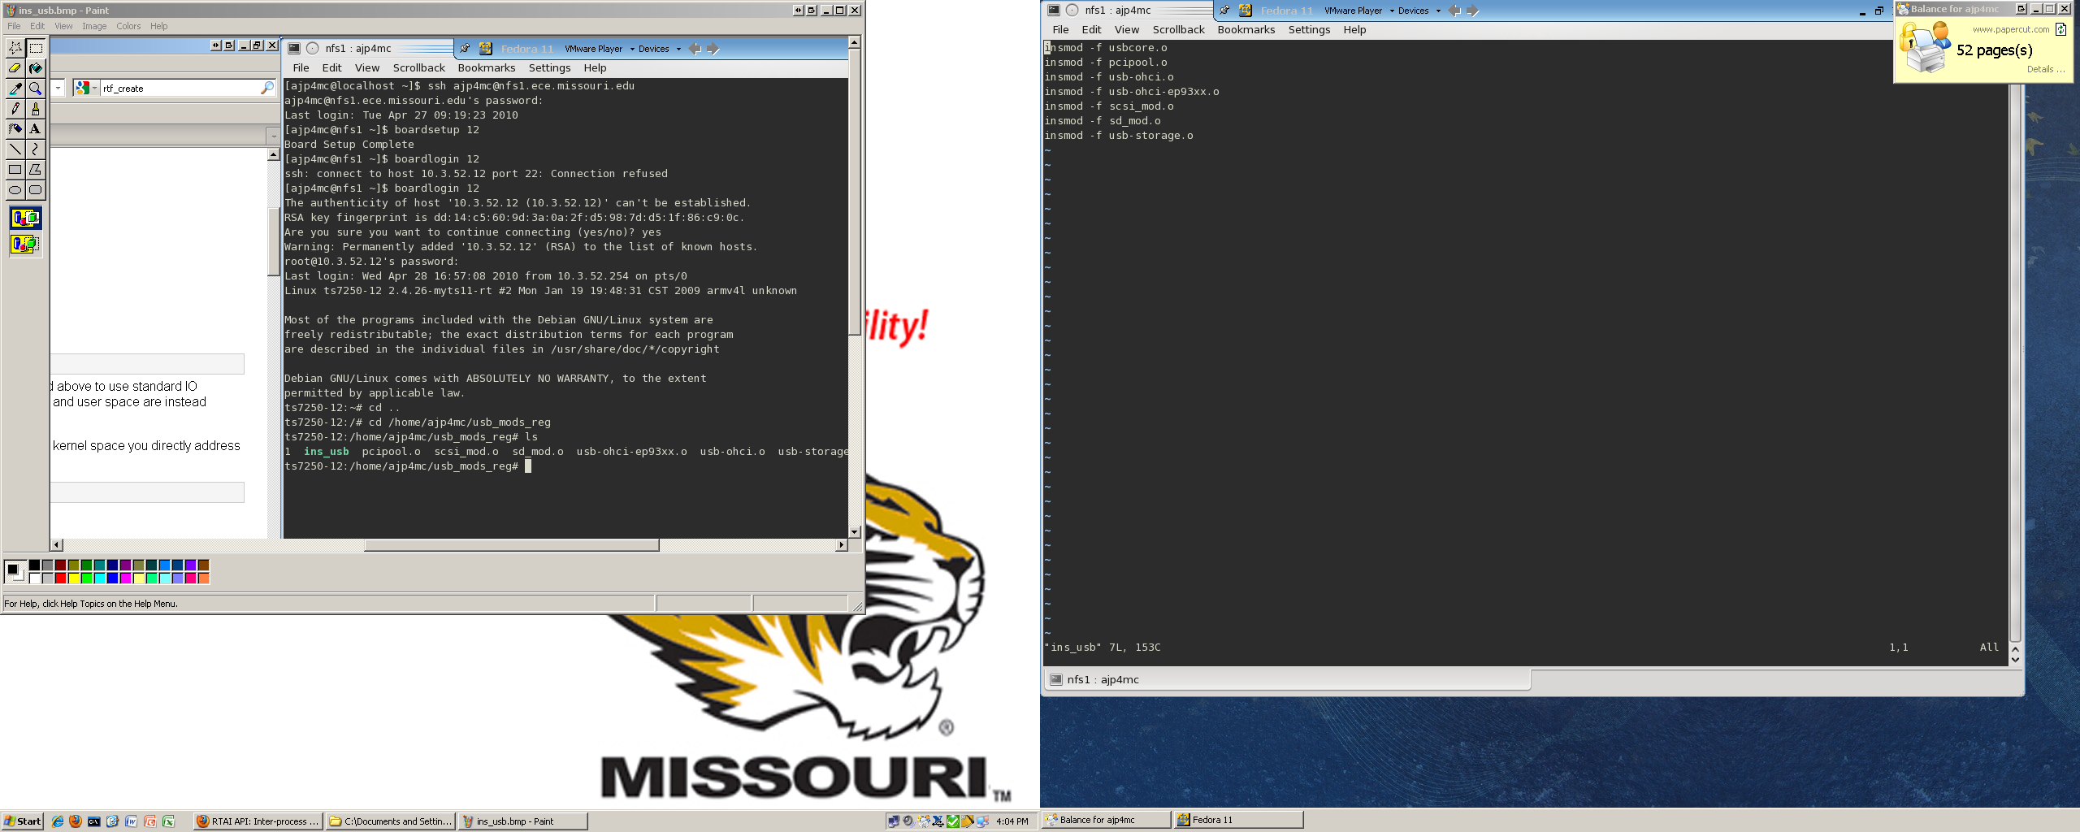
Experimental
First Steps: The USB
  Loading the USB
    Module vs. kernel version
    Forced load
    Solutions
  Formatting the USB
    Available formats
    Partition Issues

Slide 7
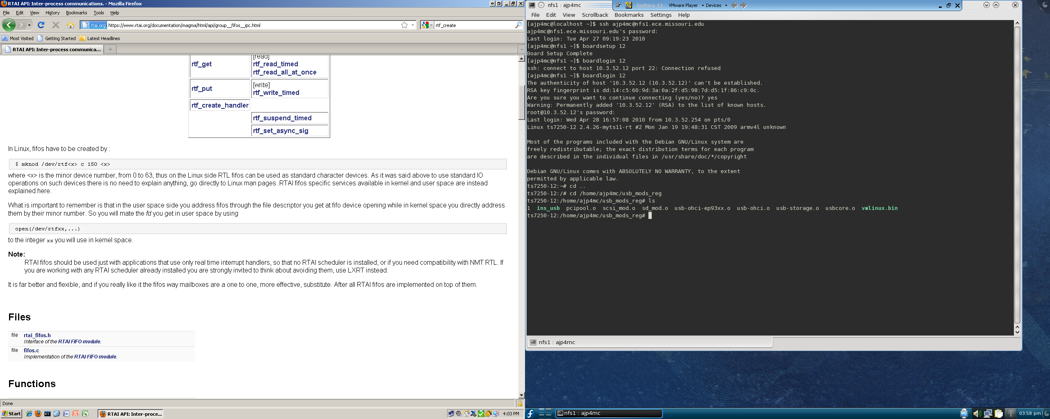
Experimental

Slide 8
Experimental
Examination of Timestamps
  How does time to process change when…?
    USB is not installed into dev/rtf
    USB is installed into dev/rtf
    USB is installed and backups of the file transfer are made
Three sets of trials, with six trials per set

Slide 9
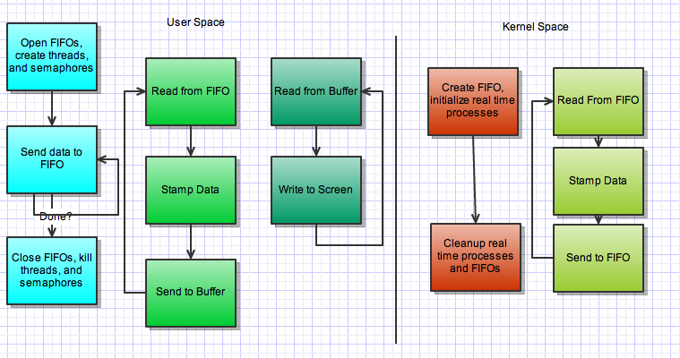
Experimental

Slide 10
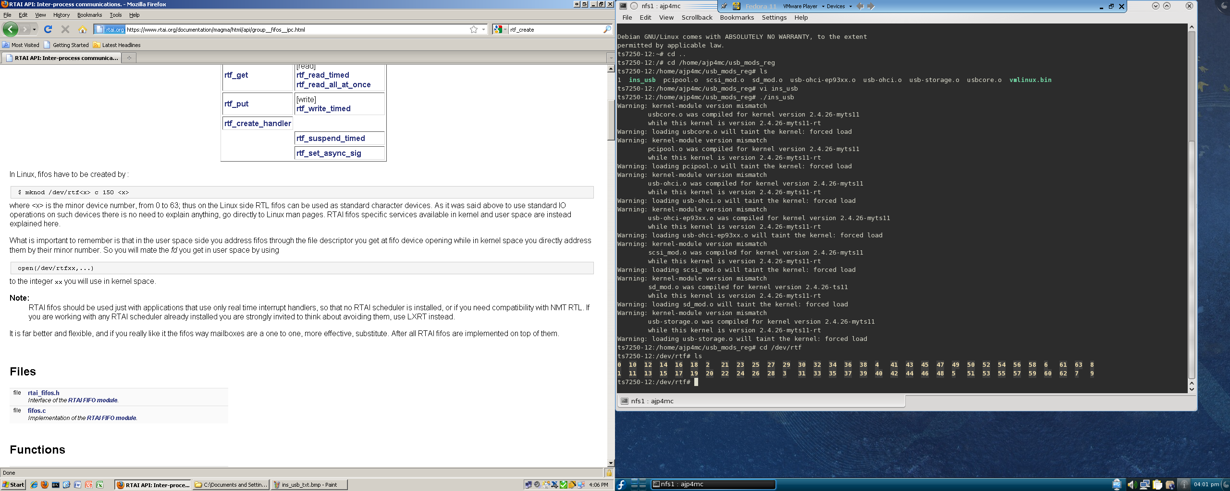
Experimental
First Trial: Control
  Uses Lab Three to get basic time stamps
  FIFOs accessed from dev/rtf as before

Slide 11
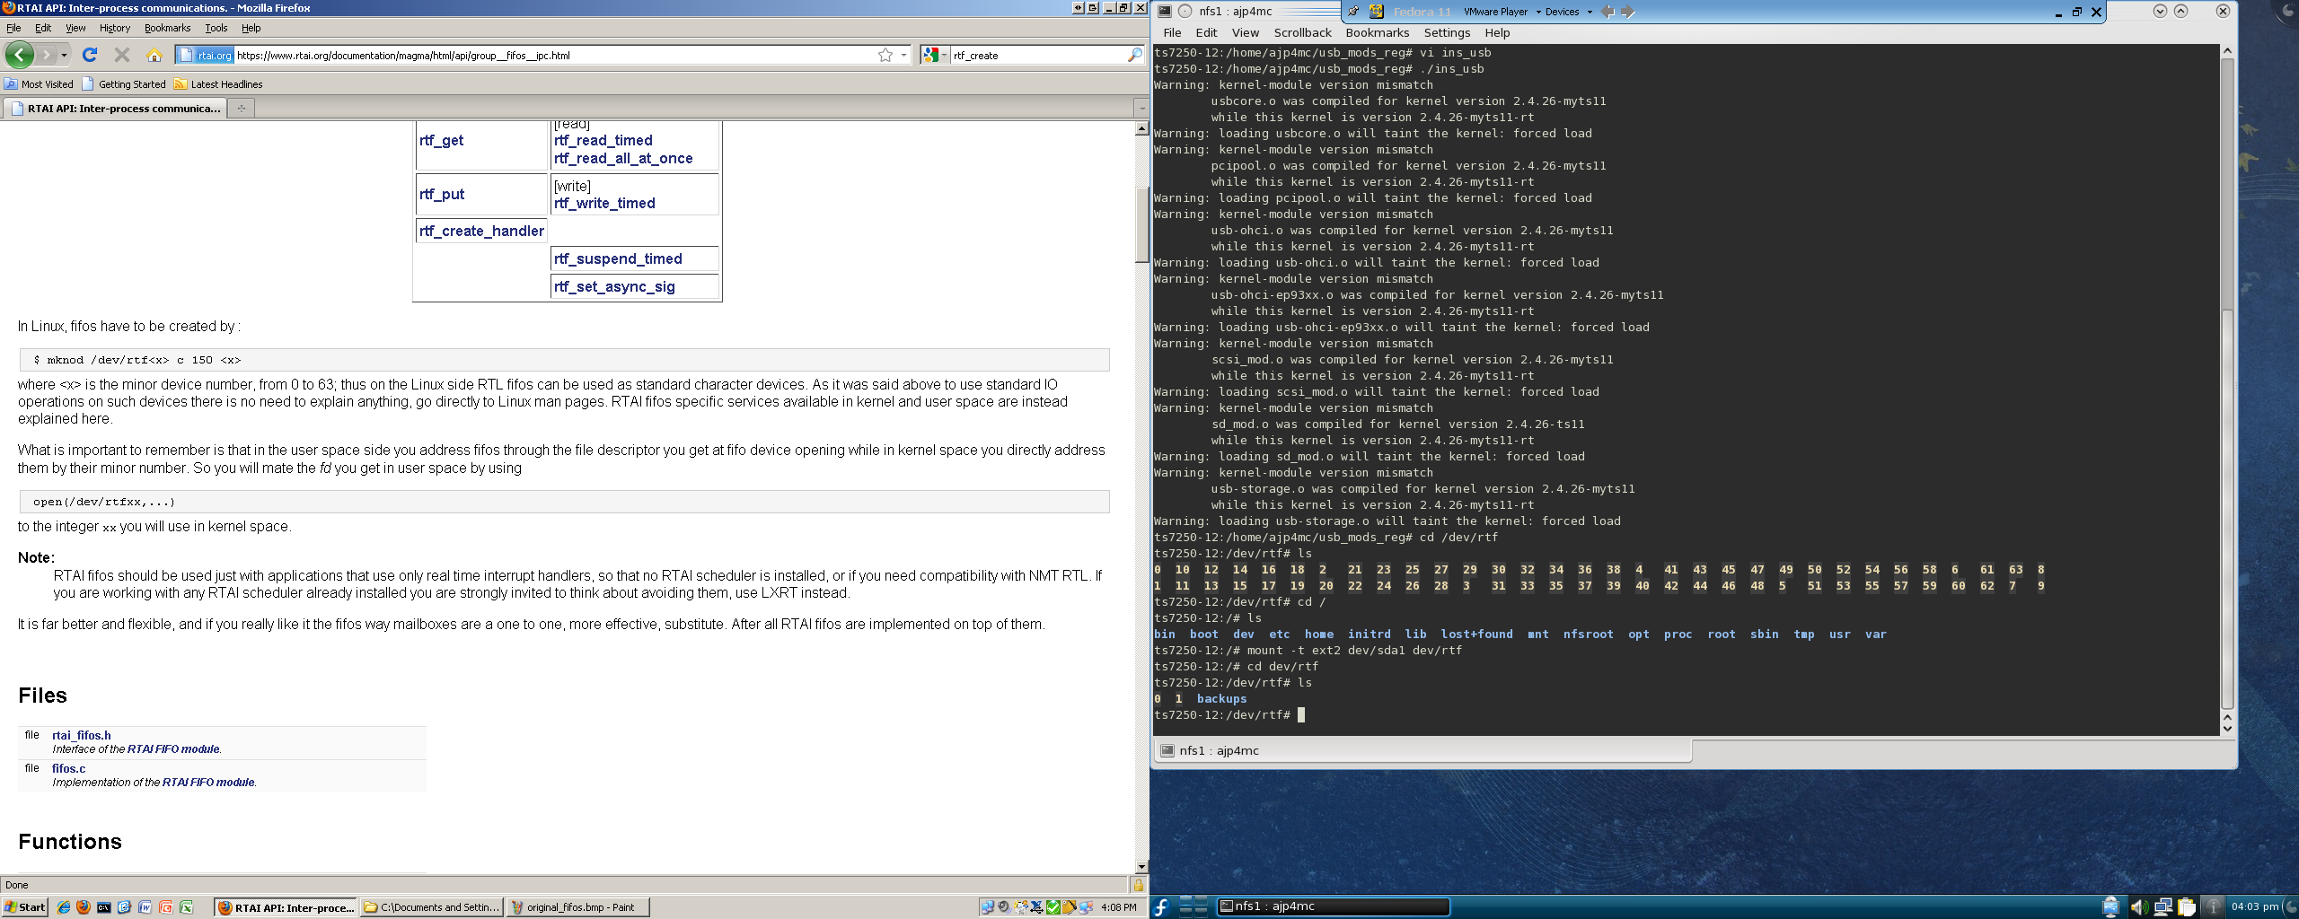
Experimental
Second Trial: USB Drive
  Drive mounted at dev/rtf
  The FIFO “locations” are recreated on the USB

Slide 12
Experimental
Third Trial: Add a backup
  Before the second time stamp is taken, a backup of the timestamp structure is saved on the USB

Slide 13
Results
Lab Five Control |  |  |  |  |  |  | Time in ns
Trial | One | Two | Three | Four | Five | Six
Stamp One | 104844027 | 108210027 | 110556027 | 115554027 | 116982027 | 122796027
Stamp Two | 104844333 | 108210231 | 110556231 | 115554231 | 116982231 | 122796231
Total Time | 306 | 204 | 204 | 204 | 204 | 204 | Average Time | 221
USB FIFO
Trial | One | Two | Three | Four | Five | Six
Stamp One | 339342027 | 343014027 | 346686027 | 350154027 | 351990027 | 353112027
Stamp Two | 339342333 | 343014231 | 346686231 | 350154231 | 351990231 | 353112231
Total Time | 306 | 204 | 204 | 204 | 204 | 204 | Average Time | 221
USB FIFO w/Backup
Trial | One | Two | Three | Four | Five | Six
Stamp One | 705318027 | 707256078 | 708684027 | 710724027 | 713172027 | 715314027
Stamp Two | 705318435 | 707256282 | 708684231 | 710724231 | 713172231 | 715314282
Total Time | 408 | 204 | 204 | 204 | 204 | 255 | Average Time | 246.5

Slide 14
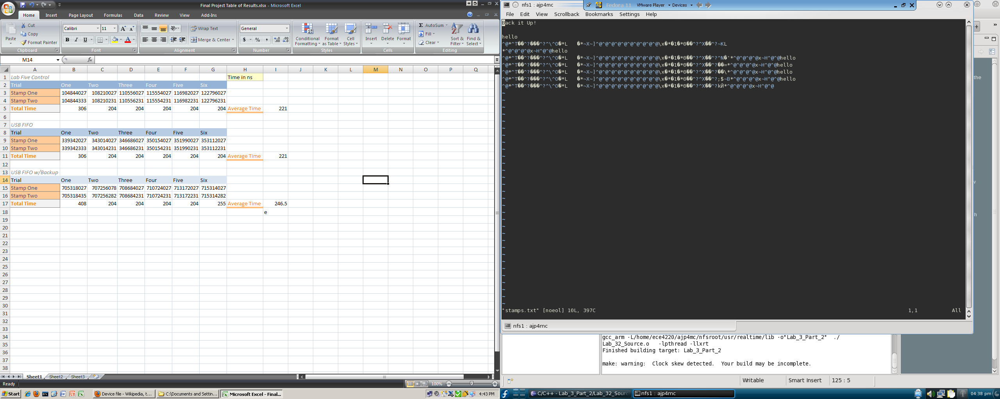
Results

Slide 15
Conclusions
When making “file” in user space to write to FIFO with, your really making a node/reference
  No, a node is not a type of file
All RTAI FIFO operations are really done in kernel space
  Simply provides a means of communication
  Nothing really happens in the user space

Slide 16
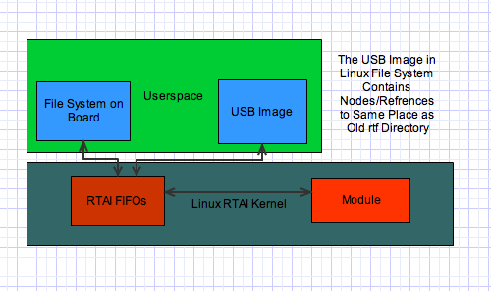
Conclusions

Slide 17
Summary
Abstract
Background
Purpose
Experimental
Results
Conclusion
Summary

Slide 18

Questions?
If we knew what we were doing, it wouldn’t be called research
- Albert Einstien

