Slide 1
TS-7250 Audio Driver
By: Russ Butler
ECE4220
Spring 2012
Dr. DeSouza
May 2, 2012

Slide 2
Introduction
The project is a music-quality audio player designed for the TS-7250 board
Stereo audio at 44.1 KHz (music CD) sample rate
This project contains:
Interface to allow any user mode program to play sound
Example user mode program that decodes .wav files and plays them

Slide 3
Purpose
Provide high-quality audio driver for TS-7250 board
Possible applications:
Music player
Audio aid for the visually impaired

Slide 4
Initial Implementation
User mode program to generate audio data
Periodic real-time task to send audio data every 22.67 US (44.1 KHz task)
UART communication to external board
Hardware to convert serial data to PWM signal
Low-pass filter and OP-Amp to filter PWM signal

Slide 5
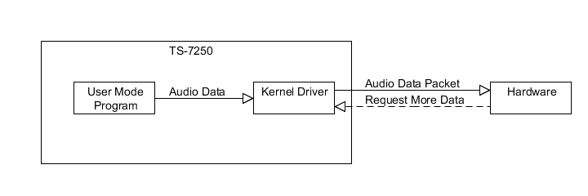
Current Implementation
User Mode program to generate data
Kernel module to take data from FIFO and transmit when requested by hardware
Hardware requests audio data in packets of 400 bytes using GPIO interrupt

Slide 6
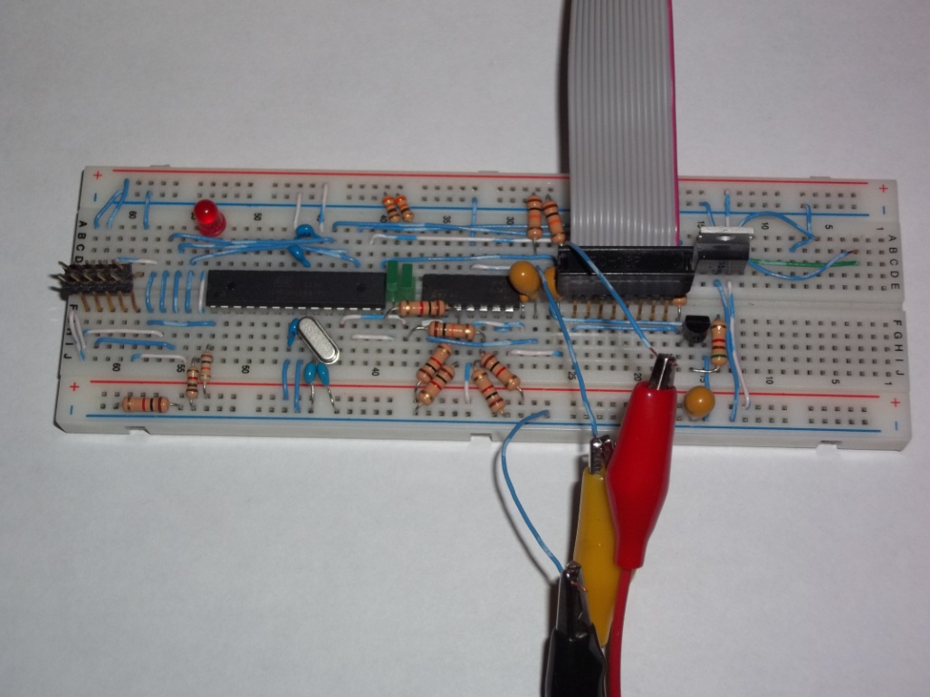
Hardware
Atmega168 microcontroller
20 MHz crystal oscillator for precise timing
Dual op-amps for high output power
High-pass filter for headset connection

Slide 7
Kernel Module
Interrupt when pin 1 of port B is low
Audio data read from real-time FIFO
Transmit packet of 400 bytes
SPI module configured for 4 MHz – packet sent in ~ 0.1 ms
Average data rate of 44.1 KHz * 2 Channels = 88.2 KB/s

Slide 8
User Mode Program
Wave file specified as command line parameter
RIFF file format parser (.wav file uses the RIFF format)
Data extracted from .wav file and sent to real-time FIFO

Slide 9
Demonstration

Slide 10
Conclusion
Able to play high-quality audio
Real time design constraints
Functional hardware
Interface for future use
Overall success

Slide 11
Questions?

