Slide 1
Logic Analyzer
ECE-4220 Real-Time Embedded Systems
Final Project
Dallas Fletchall

Slide 2
Objectives
Determine Logic Level of multiple signals
Graphical Display of Results
Tabular formatted data is hard to quickly interpret
Signal labeling improves the ease in determining system performance
Adjustable voltage levels
Allow for multiple systems with different thresholds to be analyzed

Slide 3
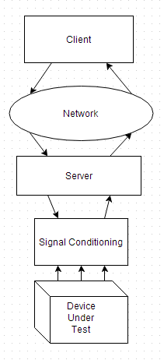
Implementation
Client-Server Model Responsibilities
Client
Requests data collection to begin
Requests changes in voltage thresholds
Display data graphically using GnuPlot Software
Responsible for user interface
Server
Respond to requests from Client
Collect data on the GPIO pins and send across network
Reformat voltage change requests for DACs
Signal Conditioning
Provide high impedance while sampling input signals
Provide variable voltages to comparator circuits

Slide 4
Implementation
Signal Conditioning
Provide high impedance to input signal
Reduces the loading effect from measuring the signal
Limit the voltage output
Ensure voltage input to data collection server is within tolerance
Allow for comparison for voltages outside tolerance of data collection Server

Slide 5
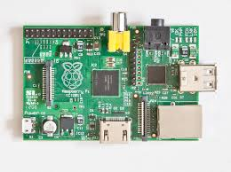
Implementation
Server Hardware
Raspberry Pi chosen as data collection server
Has 700Mhz processing core
Less than $40 cost
Available Linux Distributions to handle system calls, and decrease development time
Well documented on the web
16 general purpose input/output (GPIO) pins
Orsini, Lauren. The front of a Raspberry Pi Model B. [Photo].
Retrieved from : http://readwrite.com/2014/01/20/raspberry-pi-everything-you-need-to-know

Slide 6
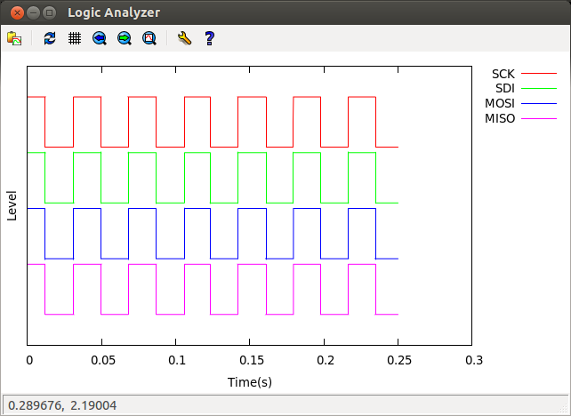
Implementation
Client Hardware
Need display capabilities
Network connection
GnuPlot Software

Slide 7
Implementation
Server Software
Message Handling
Start sampling message
Configure DAC settings
Data collection
Setup and read GPIO pins
Determine starting and stopping times
Send register value to Client for each sample
Send elapsed time to Client after sampling completion
DAC Communication
Handle SPI communications

Slide 8
Implementation
Client Software
GnuPlot Display
Handle channel labeling
Update plot after recording
Set x & y axis labels
User Input
Display options menu
Format user input
Server expects messages in certain format
Abstract how GnuPlot system works from user
Relay error messages

Slide 9
Results
Sampling Rate
333k samples/sec average
DAC accuracy
+-19.5mVdc
Graphical Display of Collected Data
Reliable Network Connection

Slide 10

Results

Slide 11
Experiments/Discussion
Sample Rate
Initial Implementation
Server stored struct timeval and an int for each channel
File was transmitted using system call, sendfile()
Advantages
Removed unnecessary implementation details from client application
sendfile(), according to man pages is supposed to be the most efficient way to transfer files
Disadvantages
Storing to a file on rasperry pi is extremely slow.
Writing to the file without sending restricted sampling rate to approximately 200k samples/sec
Each GPIO was masked and shifted individually

Slide 12
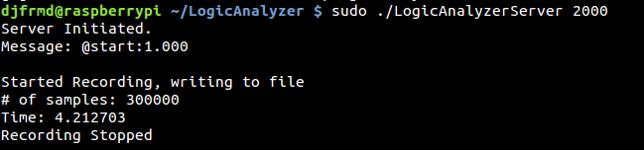
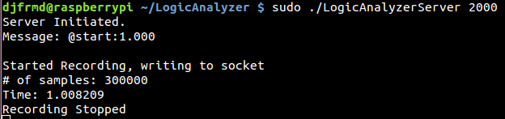
Experiments/Discussion
Time Taken to Record 300k Samples to File on Server
VS.
Time Taken to Send 300k Samples over Socket

Slide 13
Experiments/Discussion
WiringPi
Open source library
Easy access to GPIO pins and special functions
Problems
To support all versions of raspberry pi, conditional statements for board revision and pin numbering scheme are used
GPIO read entails bit masking and shifting, returning a single pin value.
8 reads necessary to determine channel values compounded unnecessary instructions
WiringPi renamed the GPIO pins to ease use, but consecutive pins were not necessarily consecutive in the GPIO level register

Slide 14
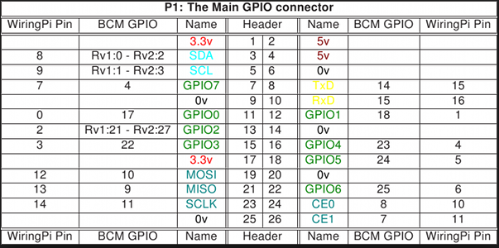
Experiments/Discussion
WiringPi Pinout Scheme
Henderson, Gordon. WiringPi pinout scheme. [Table].
Retrieved from : http://wiringpi.com/pins/

Slide 15
Experiments/Discussion
Sample Rate
Improvement
Remove calls to wiringPi API
Read and store the entire GPIO level register
Advantages
Register could be read and stored, handling masking and shifting after sampling
Removes all conditional statements
Removes need to read register value, masking, and shifting for each pin individually
Disadvantages
Difficulty setting the pin function, such as input/output, special function selection, pull-up/pull-down resistor

Slide 16
Experiments/Discussion
Implications of GPIO Selection
Advantages
Selecting 2 separate consecutive four pins allowed for less computation to mask and shift
Required less pins without need for SPI connections
Disadvantages
Serial Peripheral Interface pins were unavailable for use
Software mimicked this interface to allow for communications with DAC

Slide 17
Experiments
Sample Rate Experiments
Transmit Package Size
Create a buffer of multiple GPIO level register values and send buffer over the socket
Advantage
Maximum number of samples able to be recorded, approximately 400k samples/sec
Disadvantage
Increased samples were in bursts, with gaps in recorded data

Slide 18
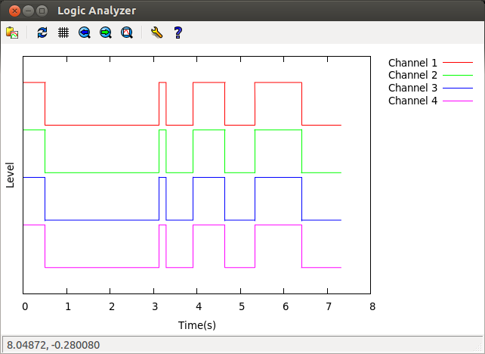
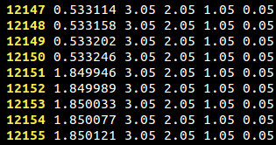
Experiments
Example of gaps in collection
using multiple register readings
sent over the network.
The text above is the file being
plotted.

Slide 19
Experiments
Sample Rate Experiments
Estimate Time of Sample
Determine sample time by equally spacing samples across total time to record all samples
Advantages
Package size decreased
Times can be calculated after sample collection
Disadvantages
Sample time accuracy not guaranteed

Slide 20
Conclusion
Failures
Sampling rate is too slow for use with serial data transfer
Real-Time system would improve due to accurate spacing between recordings.
Long interval sampling reduces accuracy
Successes
Data was able to be plotted graphically
Correct collection and display of data
Increased sampling rate can be achieved for small time intervals

