Slide 1
Song Pro Retro
Alex Harper

Slide 2
Contents of Presentation
Inspiration
Basic Concept
Speaker Module
.sng file structure
Song Pro Retro: Light
Song Pro Retro: Poly
Expandable tone library
Potential Uses

Slide 3
Inspiration
Grew up with musical background.
Integrated joy of music, with interest in embedded systems.
Used a similar program in band class to accompany me during practice.
Embedded system powered platform could allow for inexpensive solution to musical accompaniment.

Slide 4
Basic Concept
Program running on TS7250 writes sound waves values to GPIO Port D
Speaker module obtains number, and converts it to a voltage.
Using oscillating voltage, speaker module creates desired tones in series, which results in a song.
.sng file format allows for easy song development

Slide 5
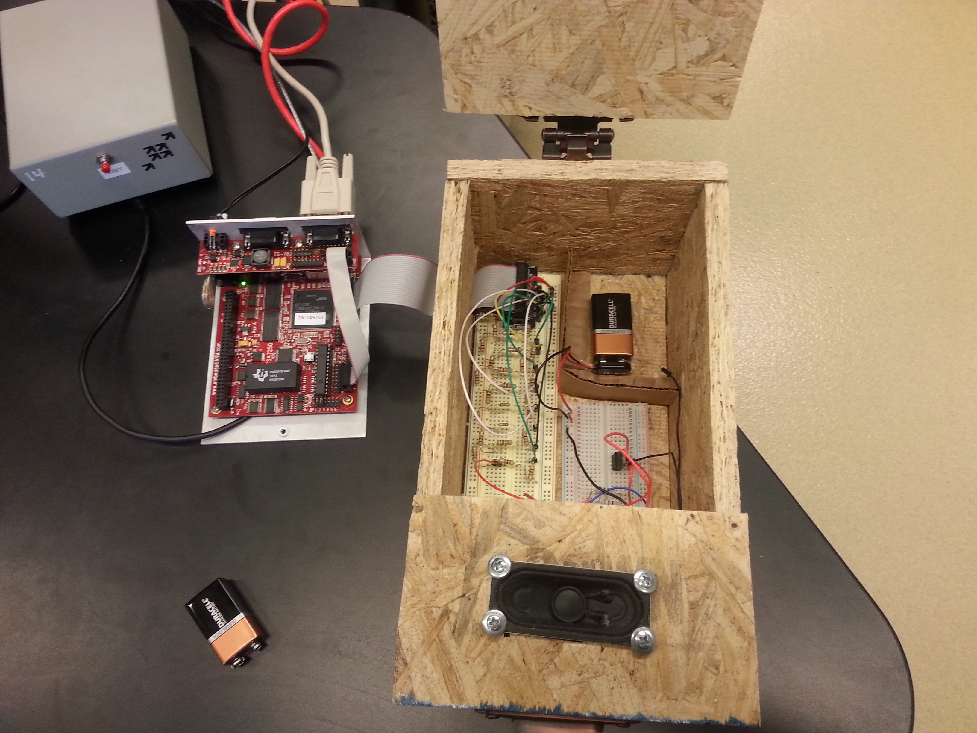
Speaker Module
Port D feeds an 8-bit number to speaker module.
R 2R DAC converts binary number into an analog voltage.
Input is amplified by transistor.
Resulting signal is passed through 4 ohm speaker.
Runs off a single 9-volt battery!!

Slide 6
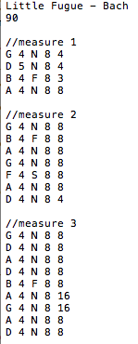
‘.sng’ file format
‘.sng’ file allows for easy transition between sheet music, and a text layout.
Song settings include song title, and tempo.
Expandable tone library allows for wide range of notes.
Line comments allow for separation of measures, allowing for easier song creation process
Parameters for notes include:
  Base note
  Octave
  Sign
  Volume
  Length

Slide 7
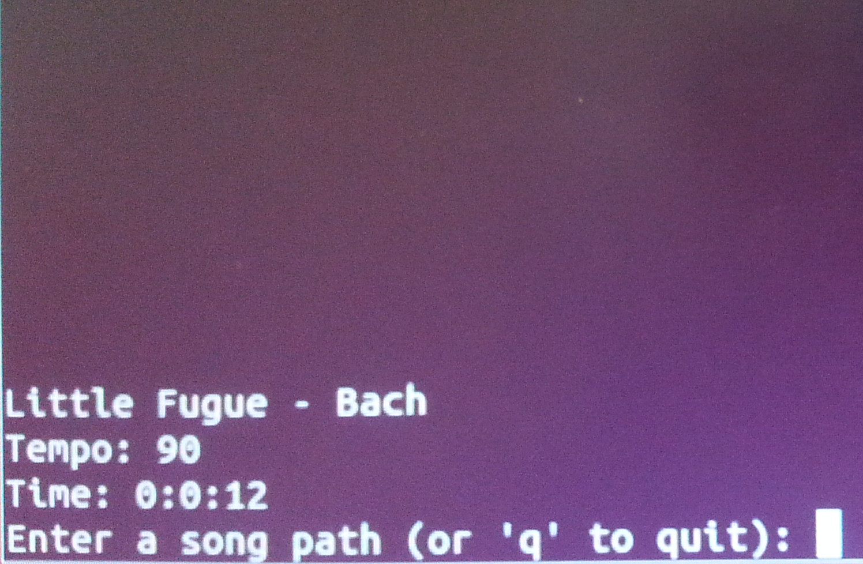
Song Pro Retro: Light
Runs on a single TS7250 board
can only generate a single instrument
Useful for accompanying a musician
Light weight process allows for ability to run on variety of real time enabled hardware.
Easy to understand user interface.

Slide 8
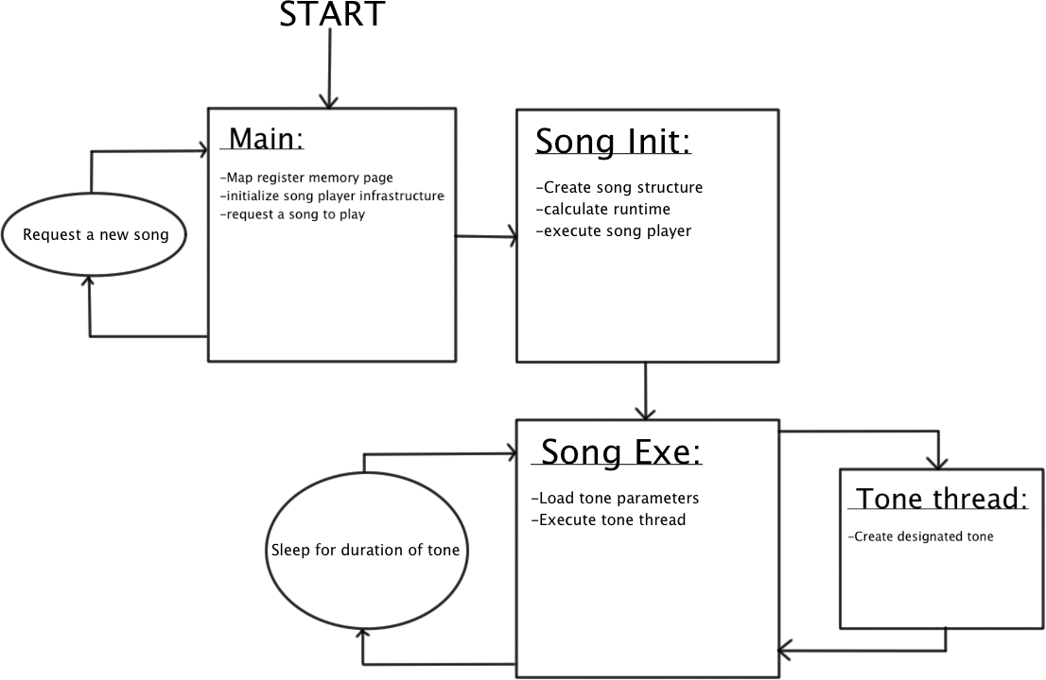
Song Pro Retro: Light

Slide 9
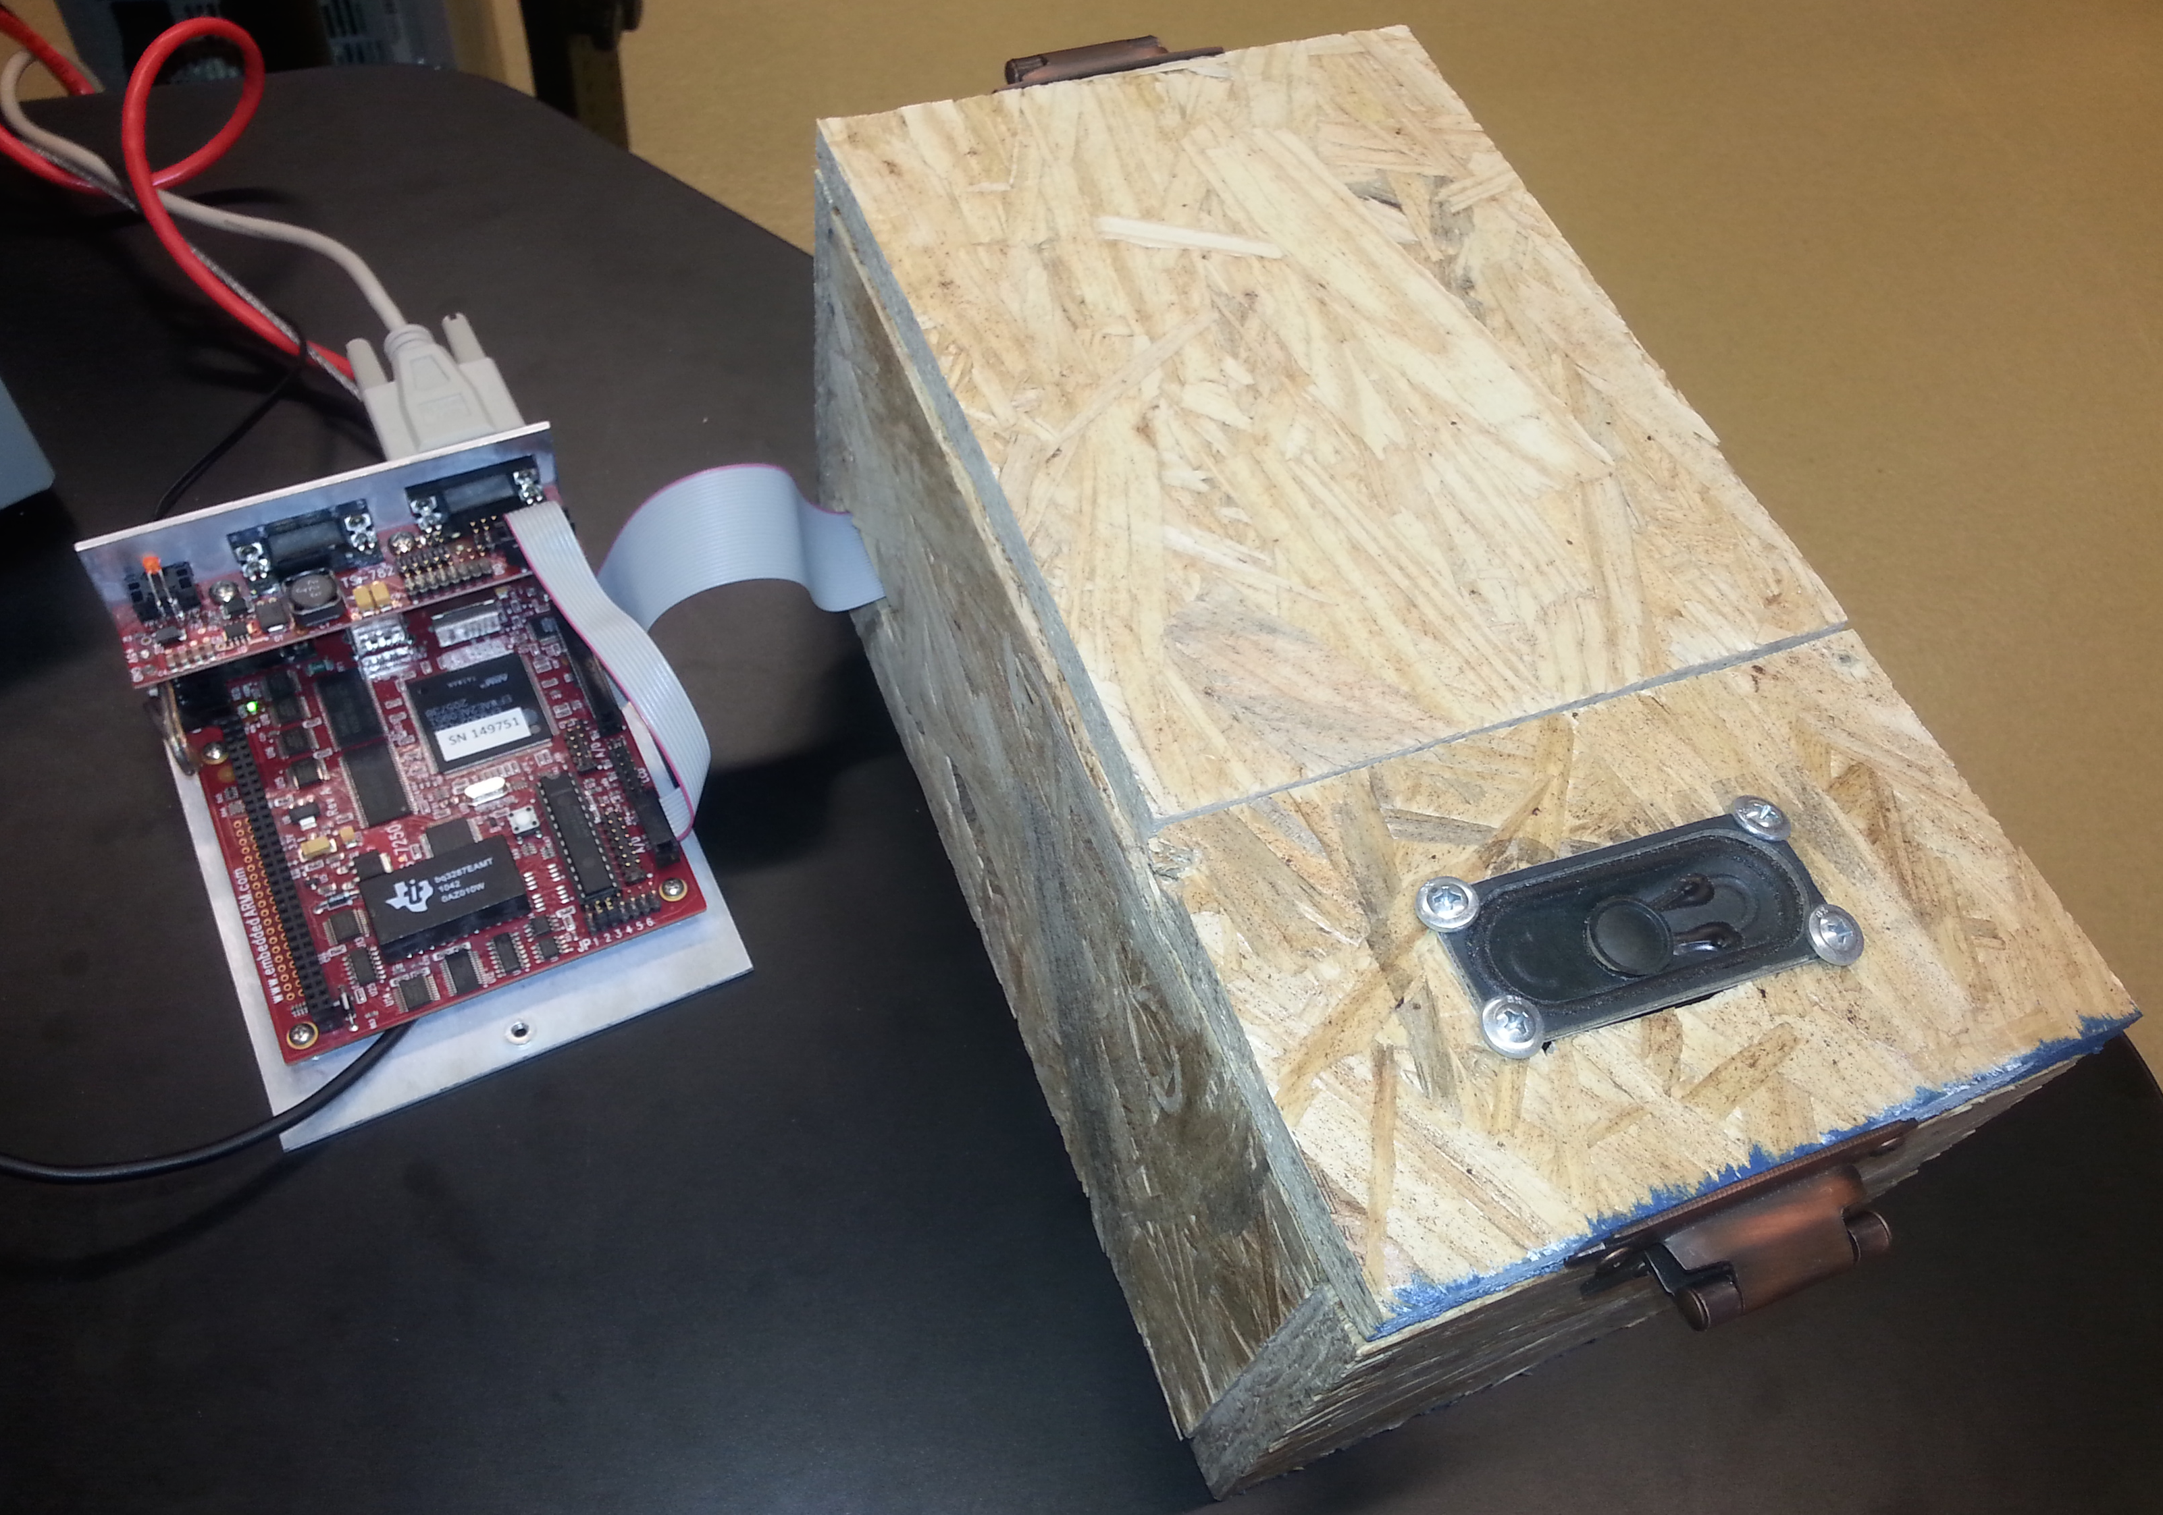
Song Pro Retro: Poly
Allows for multiple instruments to play simultaneously
Useful for simulating an entire group of musicians.
Multiple clients feed to single server.
Server combines all client feeds into a single sound wave.
Both client and server systems require a multicore embedded system, in order to supply a clean audio signal.

Slide 10
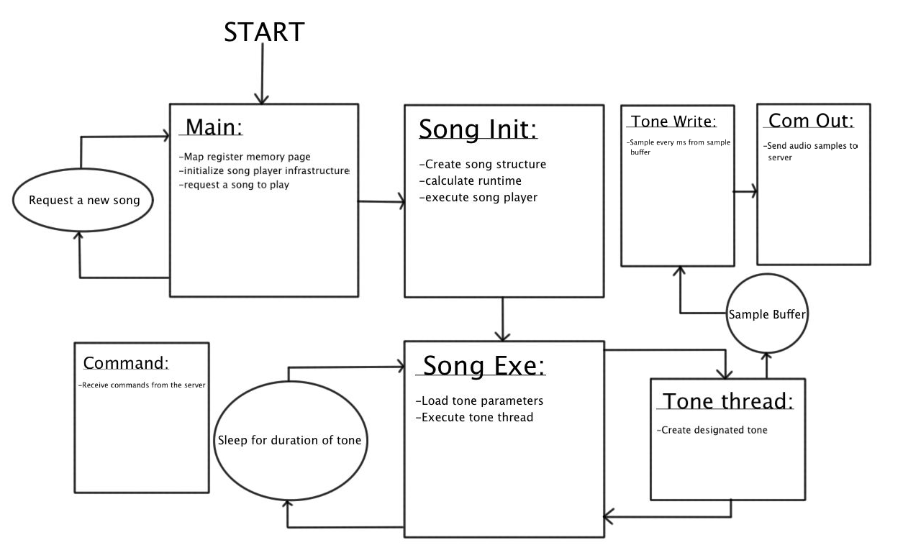
Song Pro Retro: Client

Slide 11
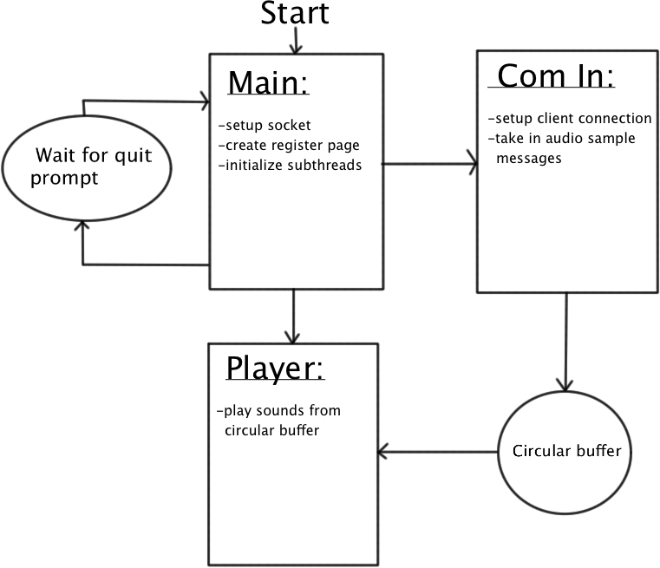
Song Pro Retro: Server

Slide 12

Expandable Sound Library
Both “Light” and “Poly” platforms use the definitions.txt file to create tones.
This tone library is easily customizable.
Allows for increased range of notes, depending on the needs of the user.
Speaker module will play frequencies between 100hz and 20khz
Columns(from left to right):
  Base note
  Octave
  Note Sign
  Frequency(multiplied by 1000)

Slide 13
Potential Uses
Musician practice companion.
Assistance in writing music, through song emulation.
Simple conversion between written sheet music, and computer generated music.

Slide 14
Thank you!

