Slide 1
Temperature Data Logger
ECE 4220 Real Time Embedded Systems
Final Project Presentation
Spring 2014
University of Missouri Columbia
By: Michael Brauch

Slide 2
Introduction
This project is designed to be a temperature data logger measuring the following with respects to time:
Current Temperature
Average Temperature
Rate of Change in Temperature

Slide 3
Key Features
Displays onto LCD interface.
Controlled via Java application from computer (TCP).
Logs data onto a removable flash drive via text file.

Slide 4
Motivation & Applications
Initial motivations were to allow the user to be able to monitor temperature conditions, both from their computer and in person.
Possible applications include:
Heating and Cooling Systems.
Geological/Environmental Temperature Surveying.

Slide 5
Problem Statements
How can we communicate between a C++ and a Java applications?
How can we accurately and purposefully present temperature data to a user?
How can we allow so many hardware components to communicate with each other?

Slide 6
Hardware Implementation

Slide 7
Hardware Components
MBED LPC1768 Microcontroller
HD44780 20x4 White Text on Blue Background LCD Interface
TMP386 Temperature Sensor
PRT-08535 – RJ45 MagJack-Compatible Ethernet Port
USB Type A Female Breakout Board
COM-09151 – Speaker – 0.5 W( 8 ohm)

Slide 8
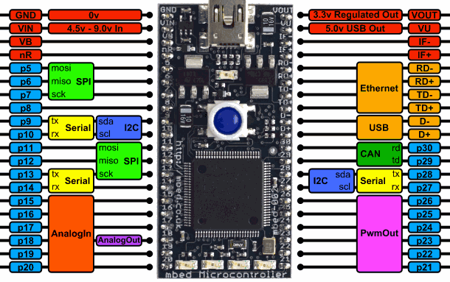
MBED LPC1768 Microcontroller
NXP LPC1768 MCU
High performance ARM® Cortex™-M3 Core
96MHz, 32KB RAM, 512KB FLASH
Ethernet, USB Host/Device, 2xSPI, 2xI2C, 3xUART, CAN, 6xPWM, 6xADC, GPIO
Prototyping form-factor
40-pin 0.1" pitch DIP package, 54x26mm
5V USB or 4.5-9V supply
Built-in USB drag 'n' drop FLASH programmer
mbed.org Developer Website
Lightweight Online Compiler
High level C/C++ SDK
Cookbook of published libraries and projects

Slide 9
Why choose MBED?
Supports many analog/digital devices and peripheral interfaces.
Includes many libraries to work with hardware components.
Real-time capabilities:
MBED RTOS based off RTX RTOS which uses the CMSIS-RTOS API (easy to use library of real-time functions).

Slide 10
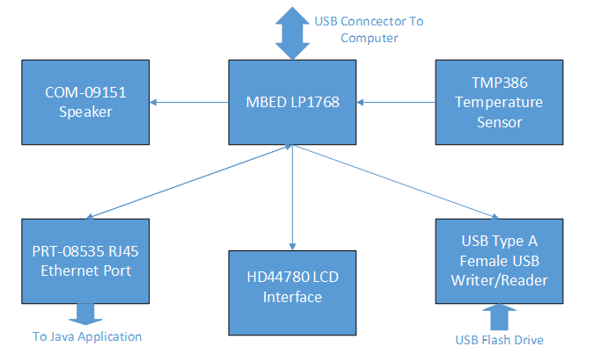
Functional Block Diagram

Slide 11
Software Implementation

Slide 12
Software Elements
Two programs: Java and C++
6 Separate Threads
TCP Connection
Mailbox (similar to FIFO)
Semaphore

Slide 13
C++ Program
Programmed using the MBED online compiler.
Allows for the hardware components to communicate with each other via multi-threading.
All data sent to LCD interface and Java application via TCP socket for display.
Logs all data in external flash drive.
Debug using COM serial port.

Slide 14
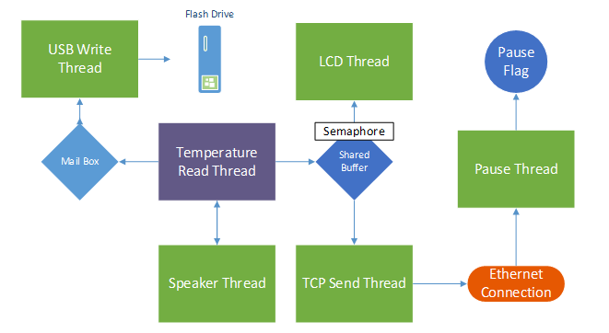
Thread Communication

Slide 15
Java Application
Connects to C++ application via TCP socket connection.
In charge of the user interface.
Will ask for IP Address of board, Port Number, Run Time, and Time Interval.
Includes a Pause/Resume button and a Stop button.

Slide 16
Flow of Program
C++ program initializes Flash Drive and Ethernet Port. Waits for TCP Connection.
Java application asks for IP Address and Port Number. Connects to the microcontroller.
Java application requests Run Time and Time Interval. Sends to the C++ program.
C++ program receives Run Time and Time interval. Initializes real-time task and threads.

Slide 17
Flow of Program (cont)
Each time Real-Time Task executes, write to flash drive, flash LEDs, and play noise through speaker.
Upon reaching the run time (or user presses Stop), C++ program displays finalized data on LCD and sends to the Java Application.
Java Application displays finalized data.

Slide 18
Demonstration

Slide 19
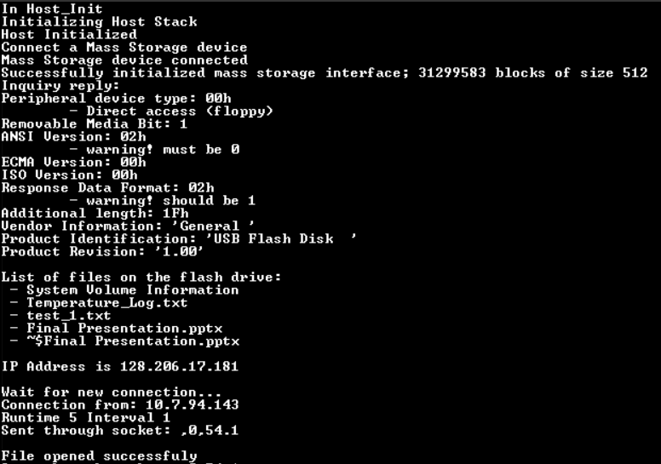
C++ Initialization

Slide 20
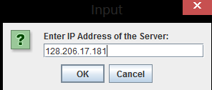
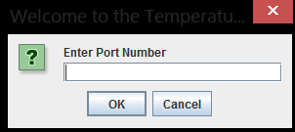
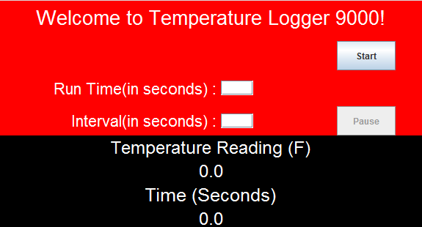
Java Initialization

Slide 21
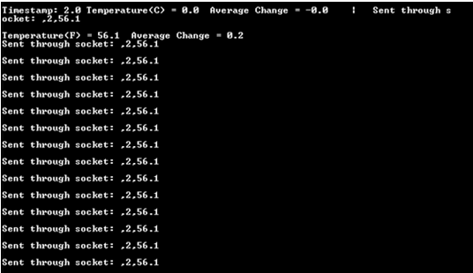

Slide 22
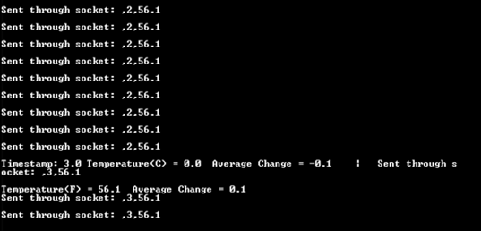

Slide 23
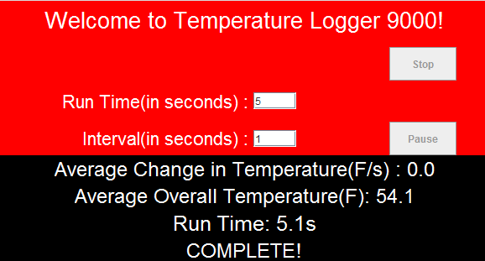
Completion
Final Screen of Java Application:

Slide 24
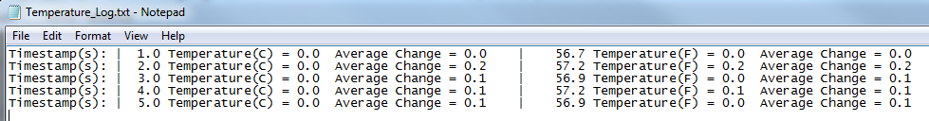
Completion
Temperature Log Text File:

Slide 25
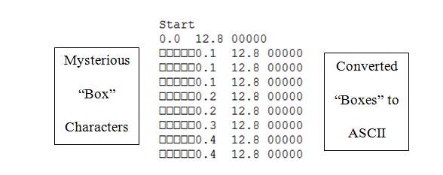
Issues Encountered
ASCII “Box” Characters.
Data Multiples Sent Through Socket.
Board Freezing Due to Lack of Memory.

Slide 26
Issues Encountered (cont)
Pause/Resume Button caused Real-Time Task to be “Out of Sync” with the Timer.
Occasionally, the Java application will Lag behind.

Slide 27
Conclusion
Although, rarely the TCP connection lagged for a few milliseconds, all tests of the project proved that it was functional and successful in obtaining the initial goal of allowing a user to monitor temperature changes and average temperature changes of a room.

Slide 28
Improvements
Implementing multiple boards at several locations.
Test with different microcontrollers with faster clocks.
Attempt to make completely wireless (i.e. no Ethernet cable or USB cable).
Additional climate sensor (such as humidity sensor).

Slide 29
Questions?

