Slide 1

Ticket Purchasing System
A Final project by chinchao suriyakul

Slide 2
Outline
Problem & Goal
Implementation
Result

Slide 3
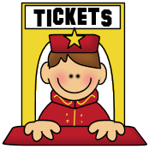
Problem and Goal
Suppose we want to create a system to sell tickets such as train or concert tickets
The goal of this project is to imitate a ticket purchasing system, which has several selling machines in several locations.
Make a main server to receive ticket orders and handle with a database
Create a local server for each location to connect with the server
Each location can have multiple selling machines
All the selling machines have to be able to run at the same time

Slide 4

System Layout
Main server with database
Local server
Local server
…..
Local server

Slide 5
Implementation
Use a TS-7250 board to represent main server and one board for each local server
The main server uses Faircom database
2 types of ticket is sold
All boards are connected on a same network
Each local server has 3 threads to represent 3 selling machine
Use a kernel module in each board to supply customer orders to the threads
Each kernel has 3 real time task with 1 ms period
Randomly generate type of ticket (type 1-2) and quantity (1-3 tickets)
Use a switch on the auxiliary board to start and stop the kernel

Slide 6
Implementation (communication)
Use socket to communicate between the servers
In the local servers, every kernel module sends data to main program through FIFO
Each local server has 2 semaphores to prevent the threads to try to access the FIFO and send messages to the main server at the same time
One thread at a time can read data from the FIFO
One thread at a time can send and receive messages with the main server

Slide 7
Implementation – (System Layout)
Main server with Faircom database
Socket
Socket
Socket
Semaphore
Local server
Semaphore
Semaphore
Local server
Semaphore
…..
Semaphore
Local server
Semaphore
(3 threads)
(3 threads)
(3 threads)
FIFO
FIFO
FIFO
Kernel module
Kernel module
Kernel module

Slide 8
Implementation – (database table)
1 table is used in the database
Type | Quantity
1 | 5000
2 | 4000

Slide 9
Implementation
3 programs are used
Main server
Handle orders and communicate with Faircom server
Local server
Send orders to the main server
Kernel module for the local server
Prepare orders for the local server

Slide 10
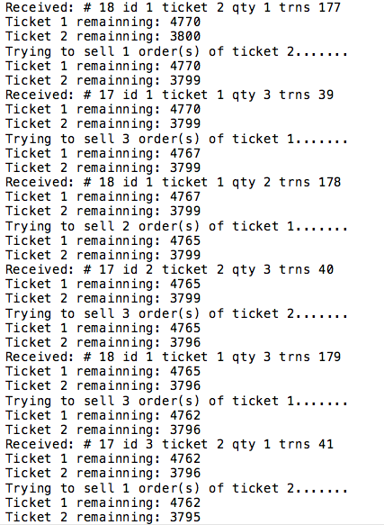
Result
Display from the server

Slide 11
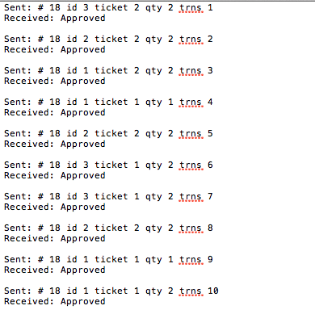
Result
Display from client 1

Slide 12
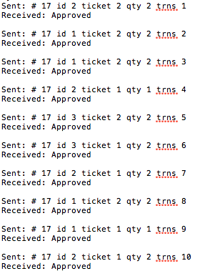
Result
Display from client 2

Slide 13
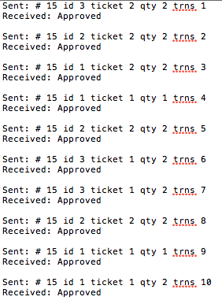
Result
Display from client 3

Slide 14
Result
Ticket summary from an experiment
 | # of ticket sold
 | Ticket 1 | Ticket 2 | Total | Grand total
Main server | 755 | 650 | 1405 | 1405
Client 1 | 359 | 318 | 677 | 1405
Client 2 | 227 | 183 | 410
Client 3 | 169 | 149 | 318

Slide 15
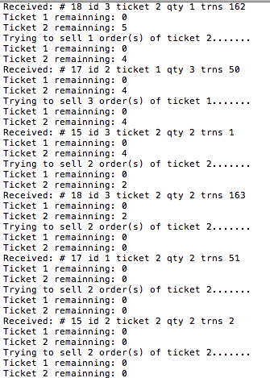
Result
Display from the server

Slide 16
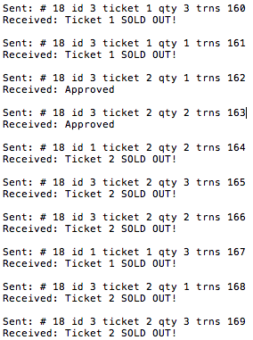
Result
Display from client 1

Slide 17
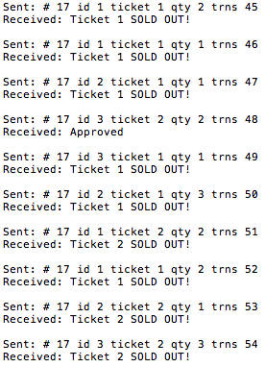
Result
Display from client 2

Slide 18
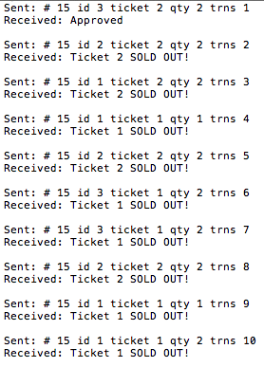
Result
Display from client 3

